Slide 1

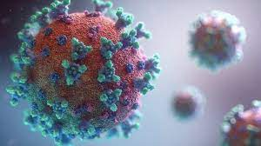


CoronaSurveys
Estimating positive cases of Covid-19
Author : Mohamed Kacem Host organism tutor : Antonio Fernández Anta ENSTA Tutor : Andrea Simonetto

Slide 2
CoronaSurveys
A collaborative project between several universities and research institutions in the world
Author : Mohamed Kacem Host org tutor : Antonio Fernández Anta ENSTA Tutor : Andrea Simonetto

Slide 3


Data used in this project
Data collection
🇺🇸
Author : Mohamed Kacem Host org tutor : Antonio Fernández Anta ENSTA Tutor : Andrea Simonetto

Slide 4
Data processing steps
Initial data
1 file / month
1 folder / month
1 file / state
total
1 file / state
Dates2micro
Micro2
total
Total2
dummies
ML models
Models
Generation
dummies
1 file / state
Aggregated files
1 file / state
Dummies 2
aggregates
Author : Mohamed Kacem Host org tutor : Antonio Fernández Anta ENSTA Tutor : Andrea Simonetto

Slide 5
Classification
Train = ground-truth
Self reported
symptoms
Machine Learning Classifiers
CMU CLI : fever + an other symtom
CLI Local : CMU CLI in household
Logistic regression
XGBoost
Random Forest
Linear SVM
Neutral Network
Author : Mohamed Kacem Host org tutor : Antonio Fernández Anta ENSTA Tutor : Andrea Simonetto

Slide 6
Train data : The ground truth
Test data :
Vaccinated with
One dose
Vaccinated with
two doses
ALL
Unvaccinated
Vaccinated
Author : Mohamed Kacem Host org tutor : Antonio Fernández Anta ENSTA Tutor : Andrea Simonetto

Slide 7
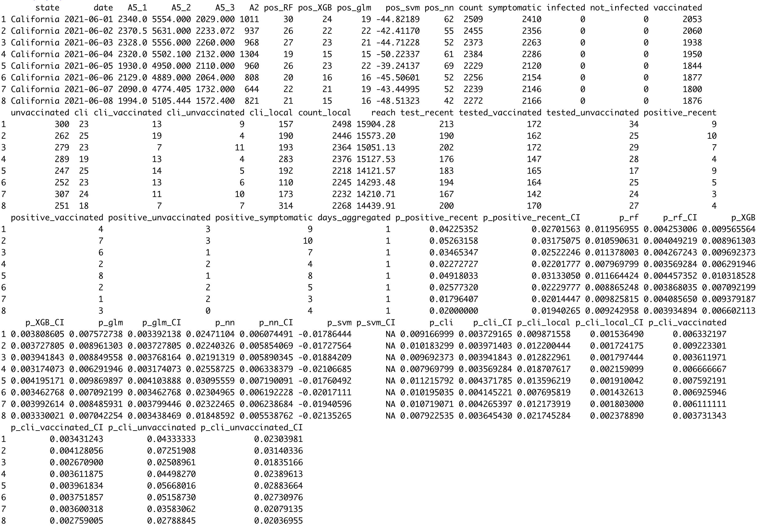
Author : Mohamed Kacem Host org tutor : Antonio Fernández Anta ENSTA Tutor : Andrea Simonetto

Slide 8
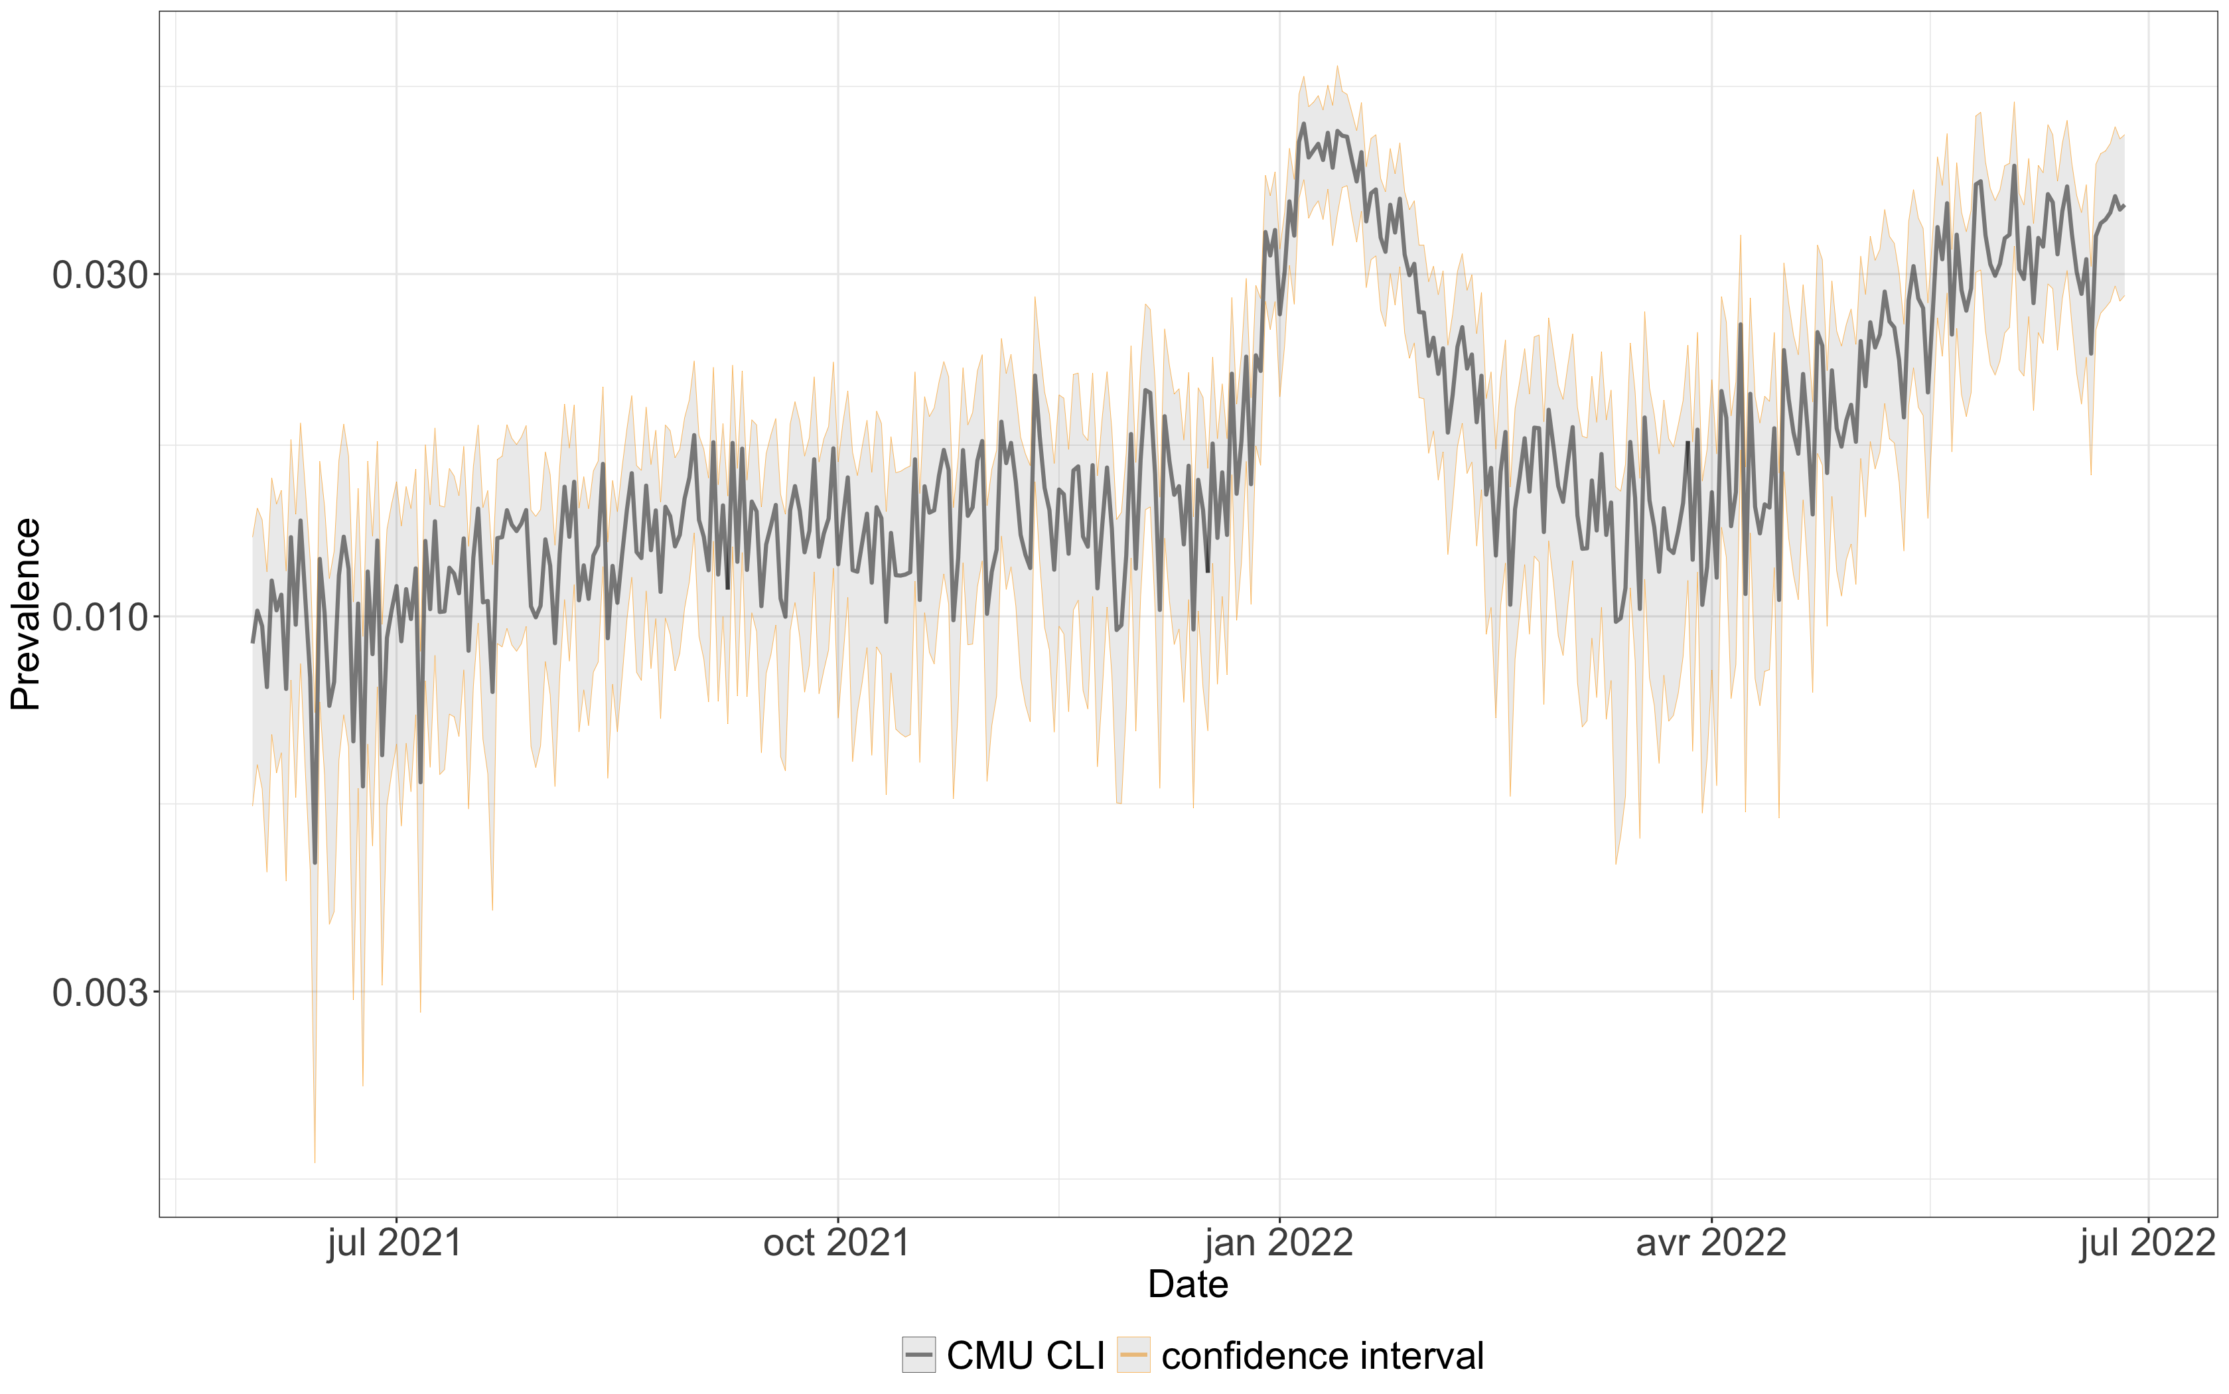
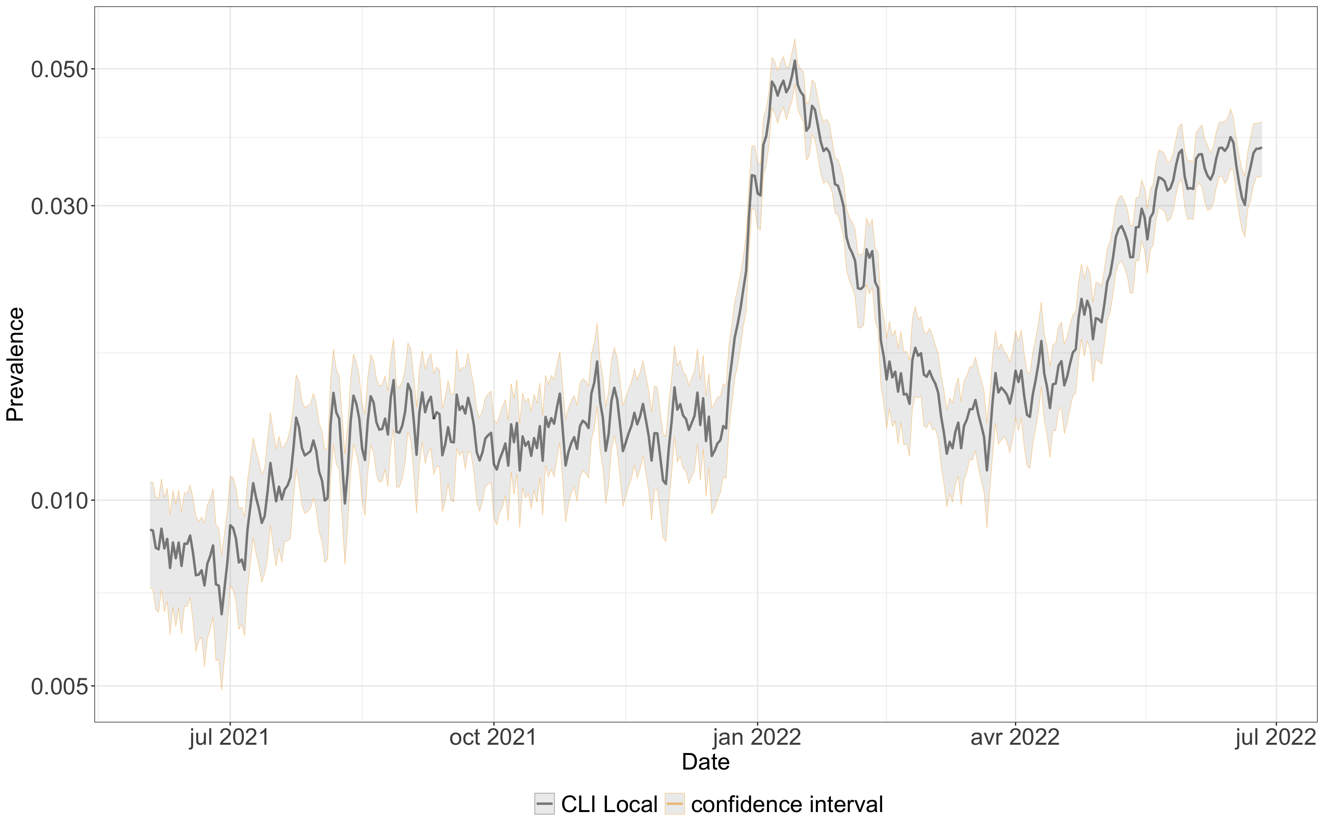
Prevalence in California using CMU CLI classifier
Prevalence in California using CLI Local
Author : Mohamed Kacem Host org tutor : Antonio Fernández Anta ENSTA Tutor : Andrea Simonetto

Slide 9
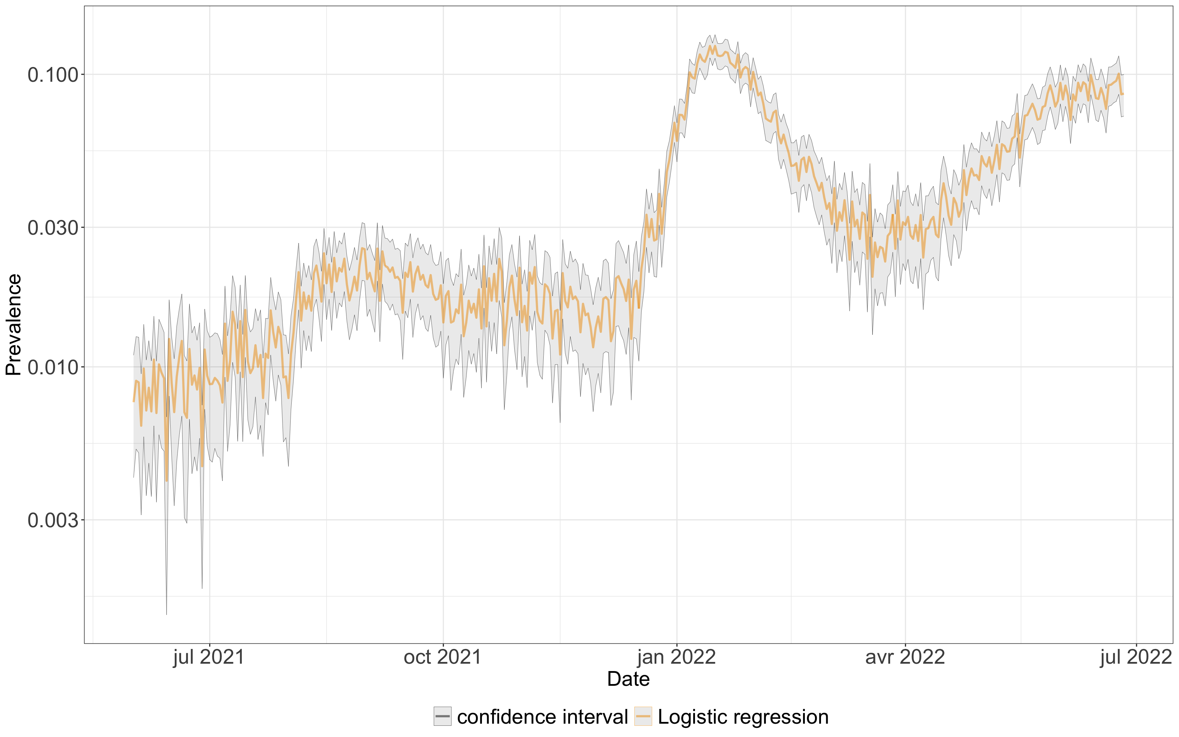
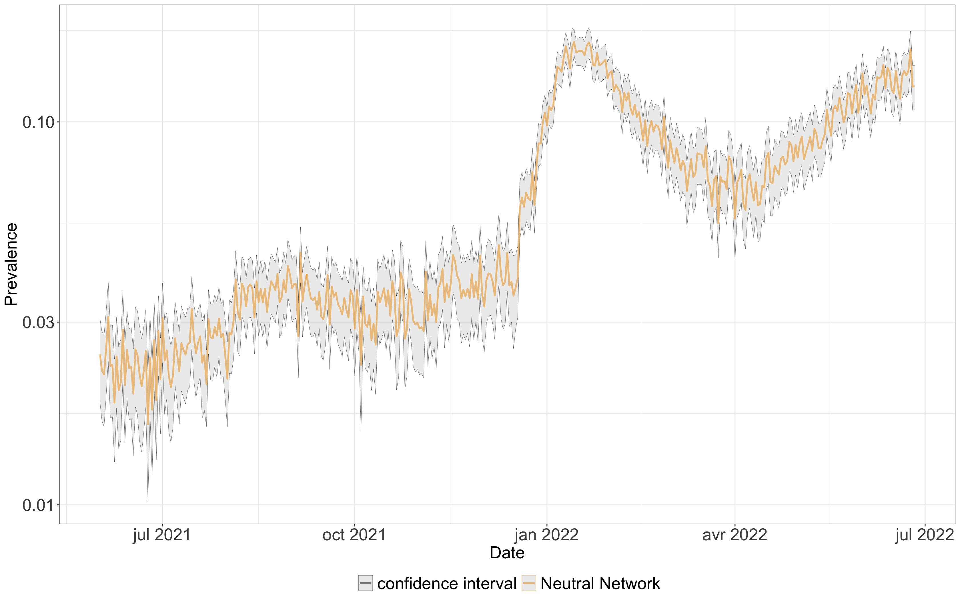
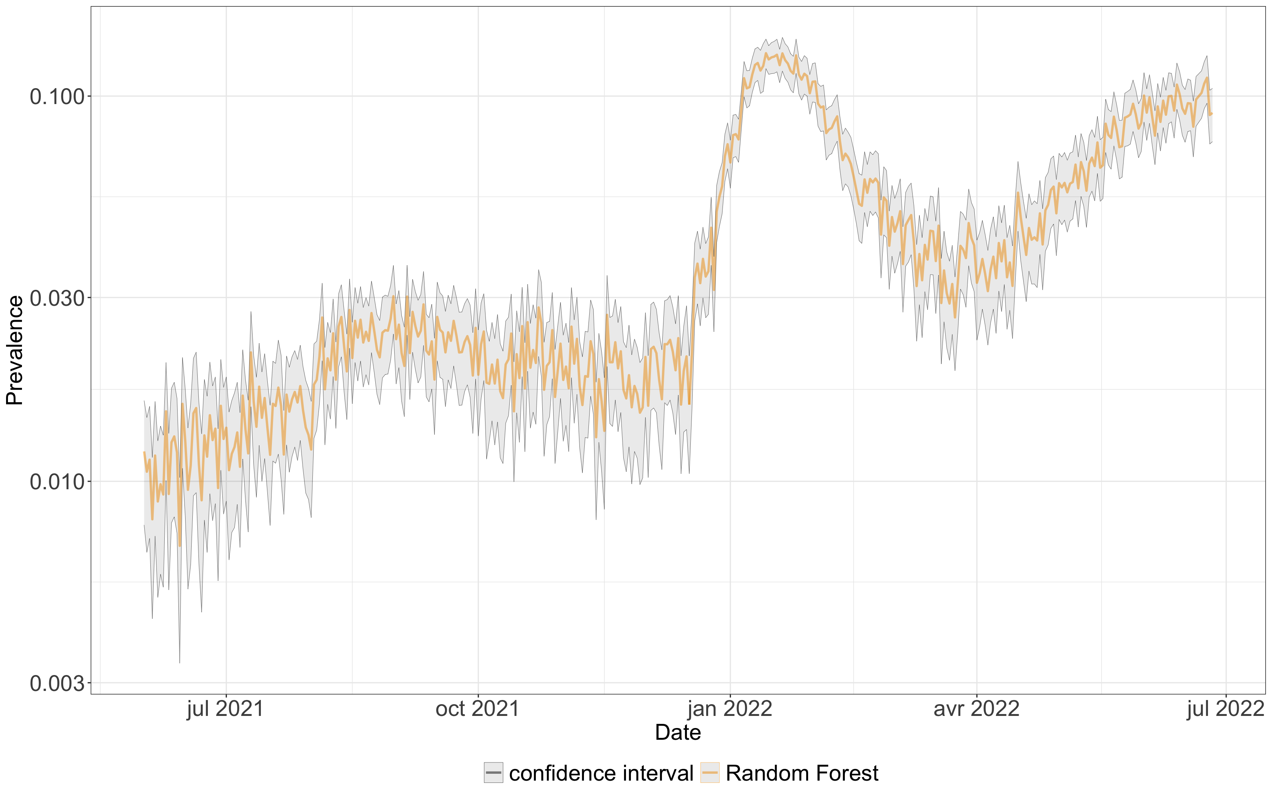
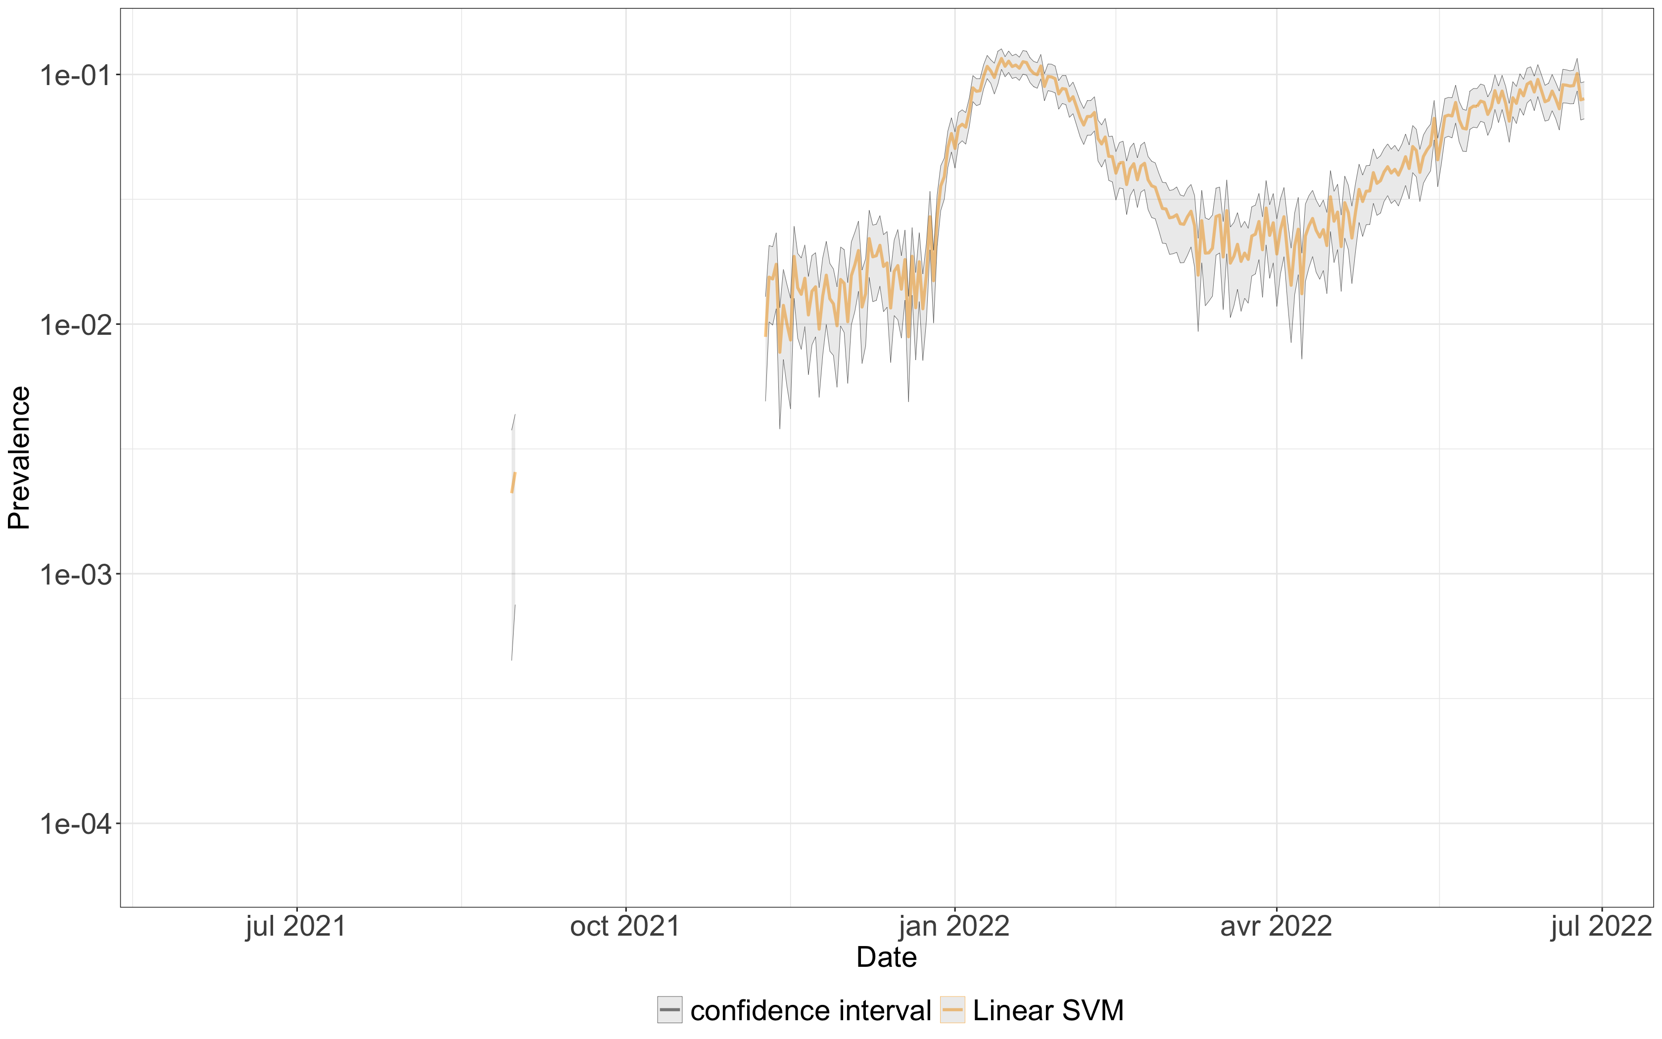
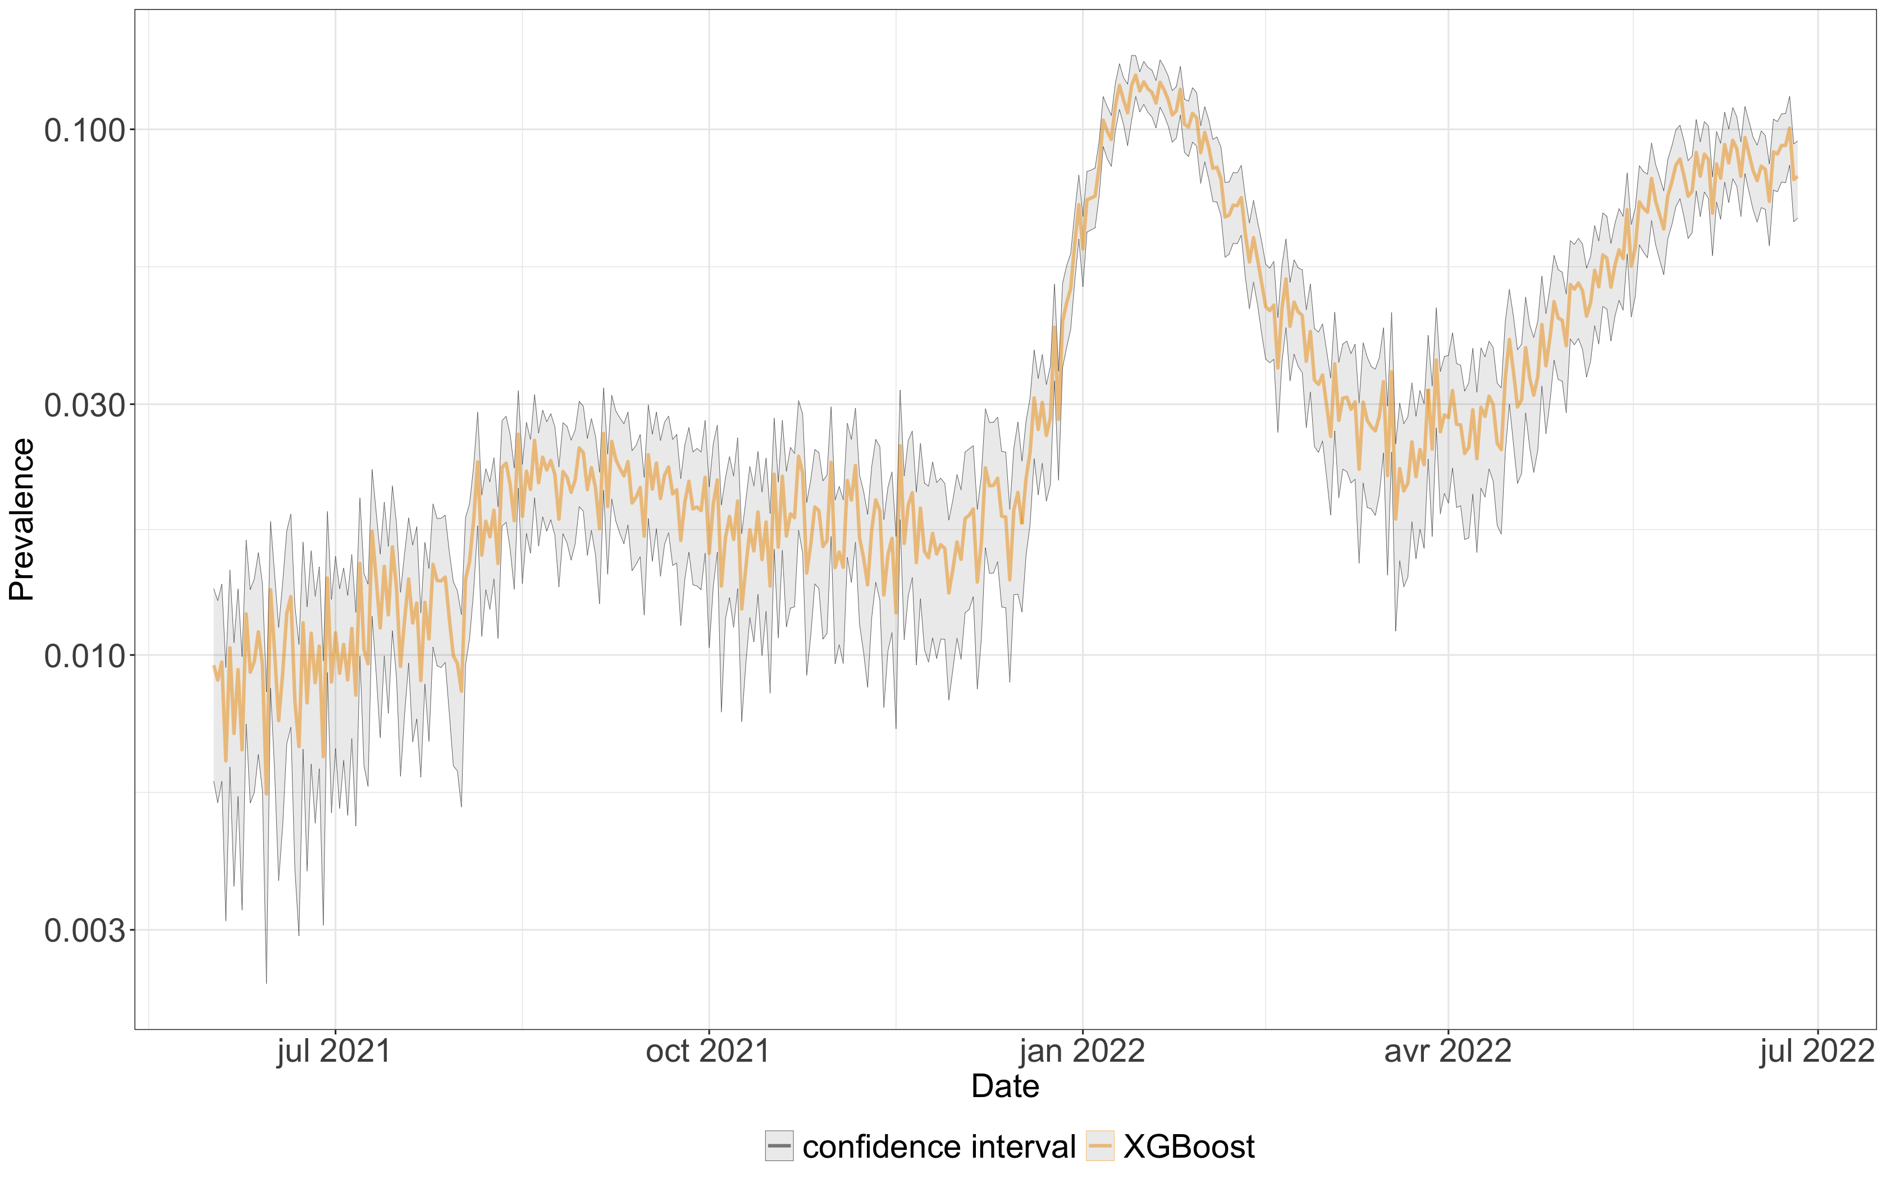
Prevalence in California using LR, XGBoost, RF, Lin svm, NN
Author : Mohamed Kacem Host org tutor : Antonio Fernández Anta ENSTA Tutor : Andrea Simonetto

Slide 10
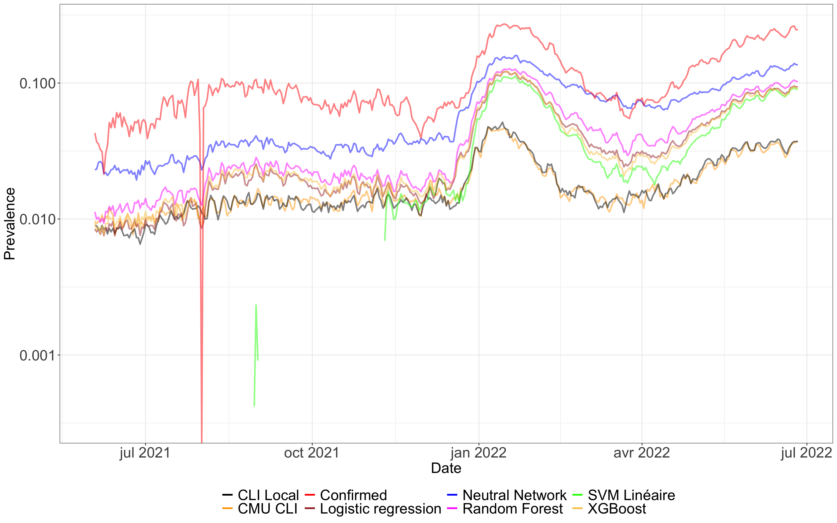
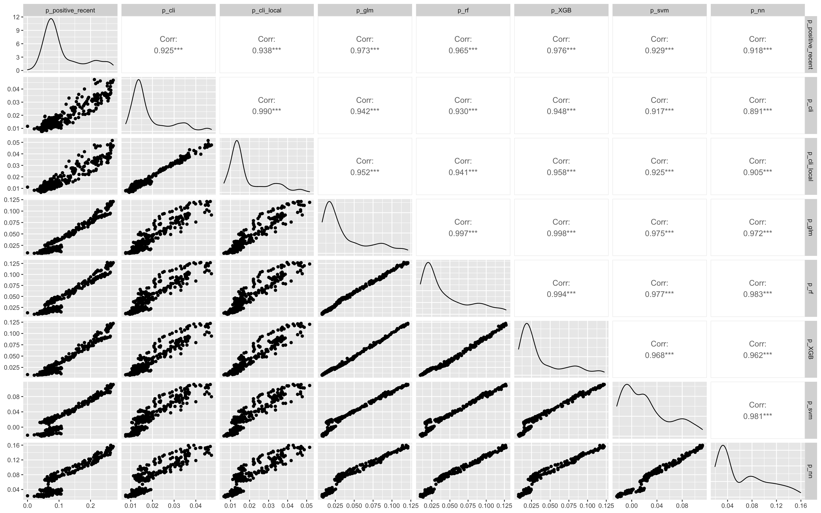
Author : Mohamed Kacem Host org tutor : Antonio Fernández Anta ENSTA Tutor : Andrea Simonetto

Slide 11
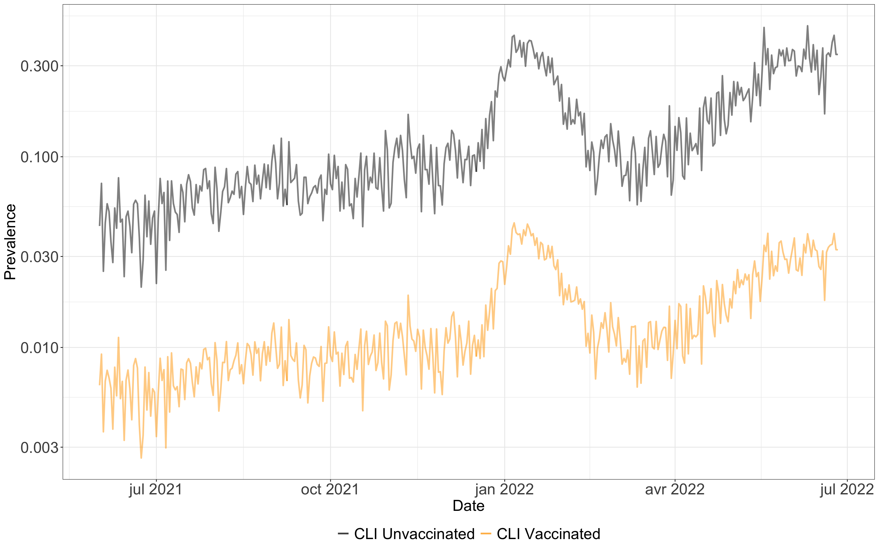
The prevalence in California among Vaccinated and unvaccinated people
Probability of 10 times more to get the covid
Author : Mohamed Kacem Host org tutor : Antonio Fernández Anta ENSTA Tutor : Andrea Simonetto

Slide 12
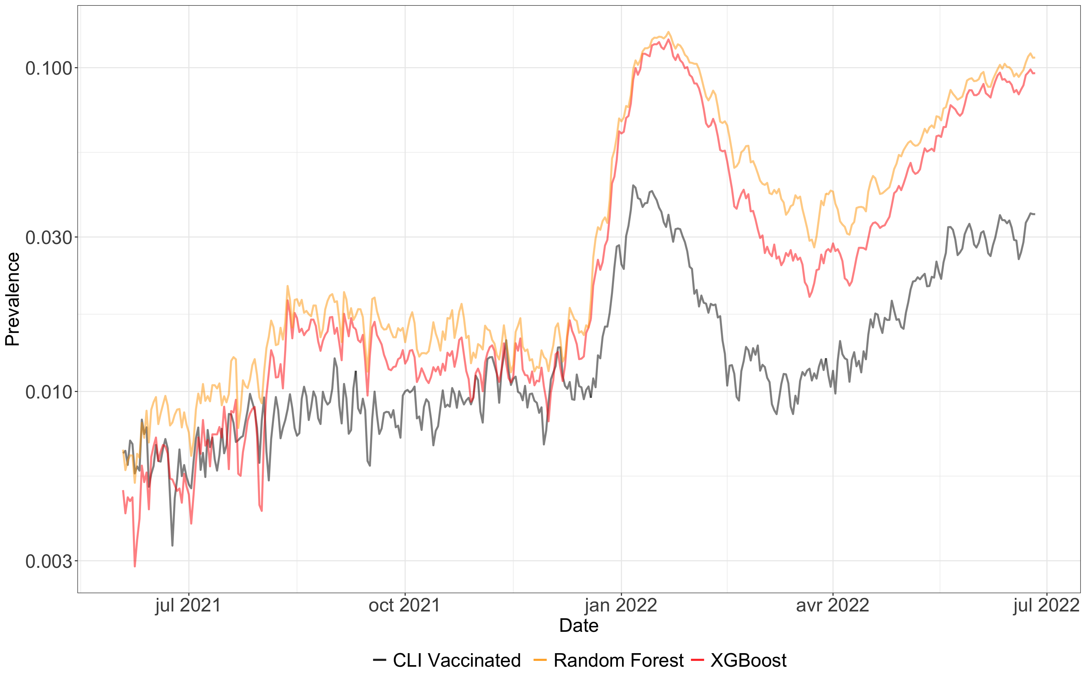
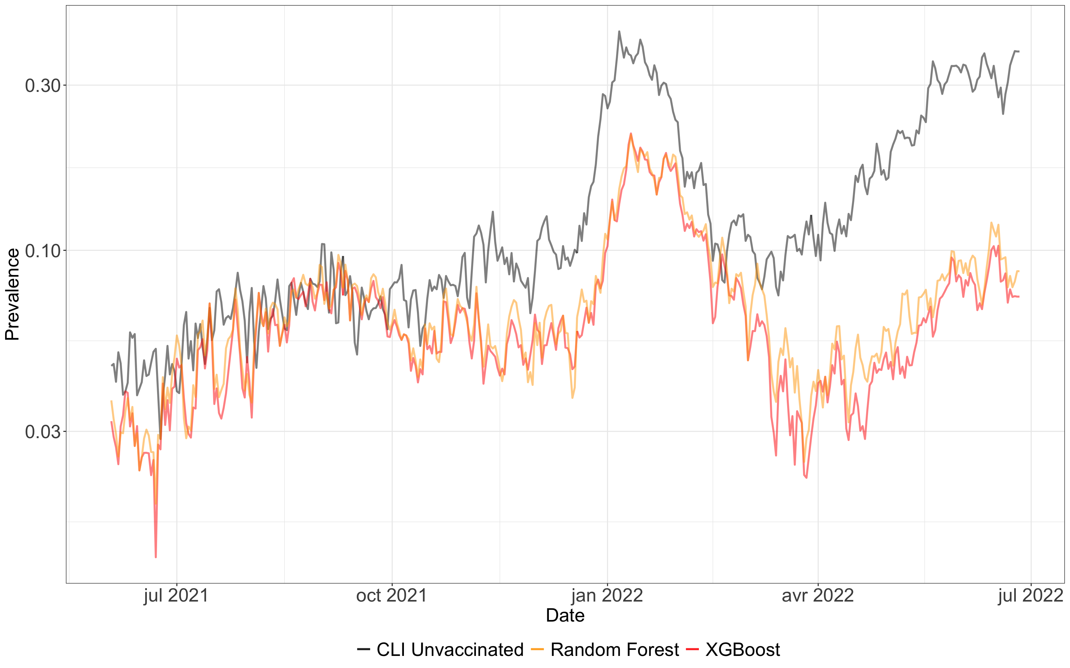
prevalence in California among Vaccinated, Unvaccinated with different proxies
Author : Mohamed Kacem Host org tutor : Antonio Fernández Anta ENSTA Tutor : Andrea Simonetto

Slide 13
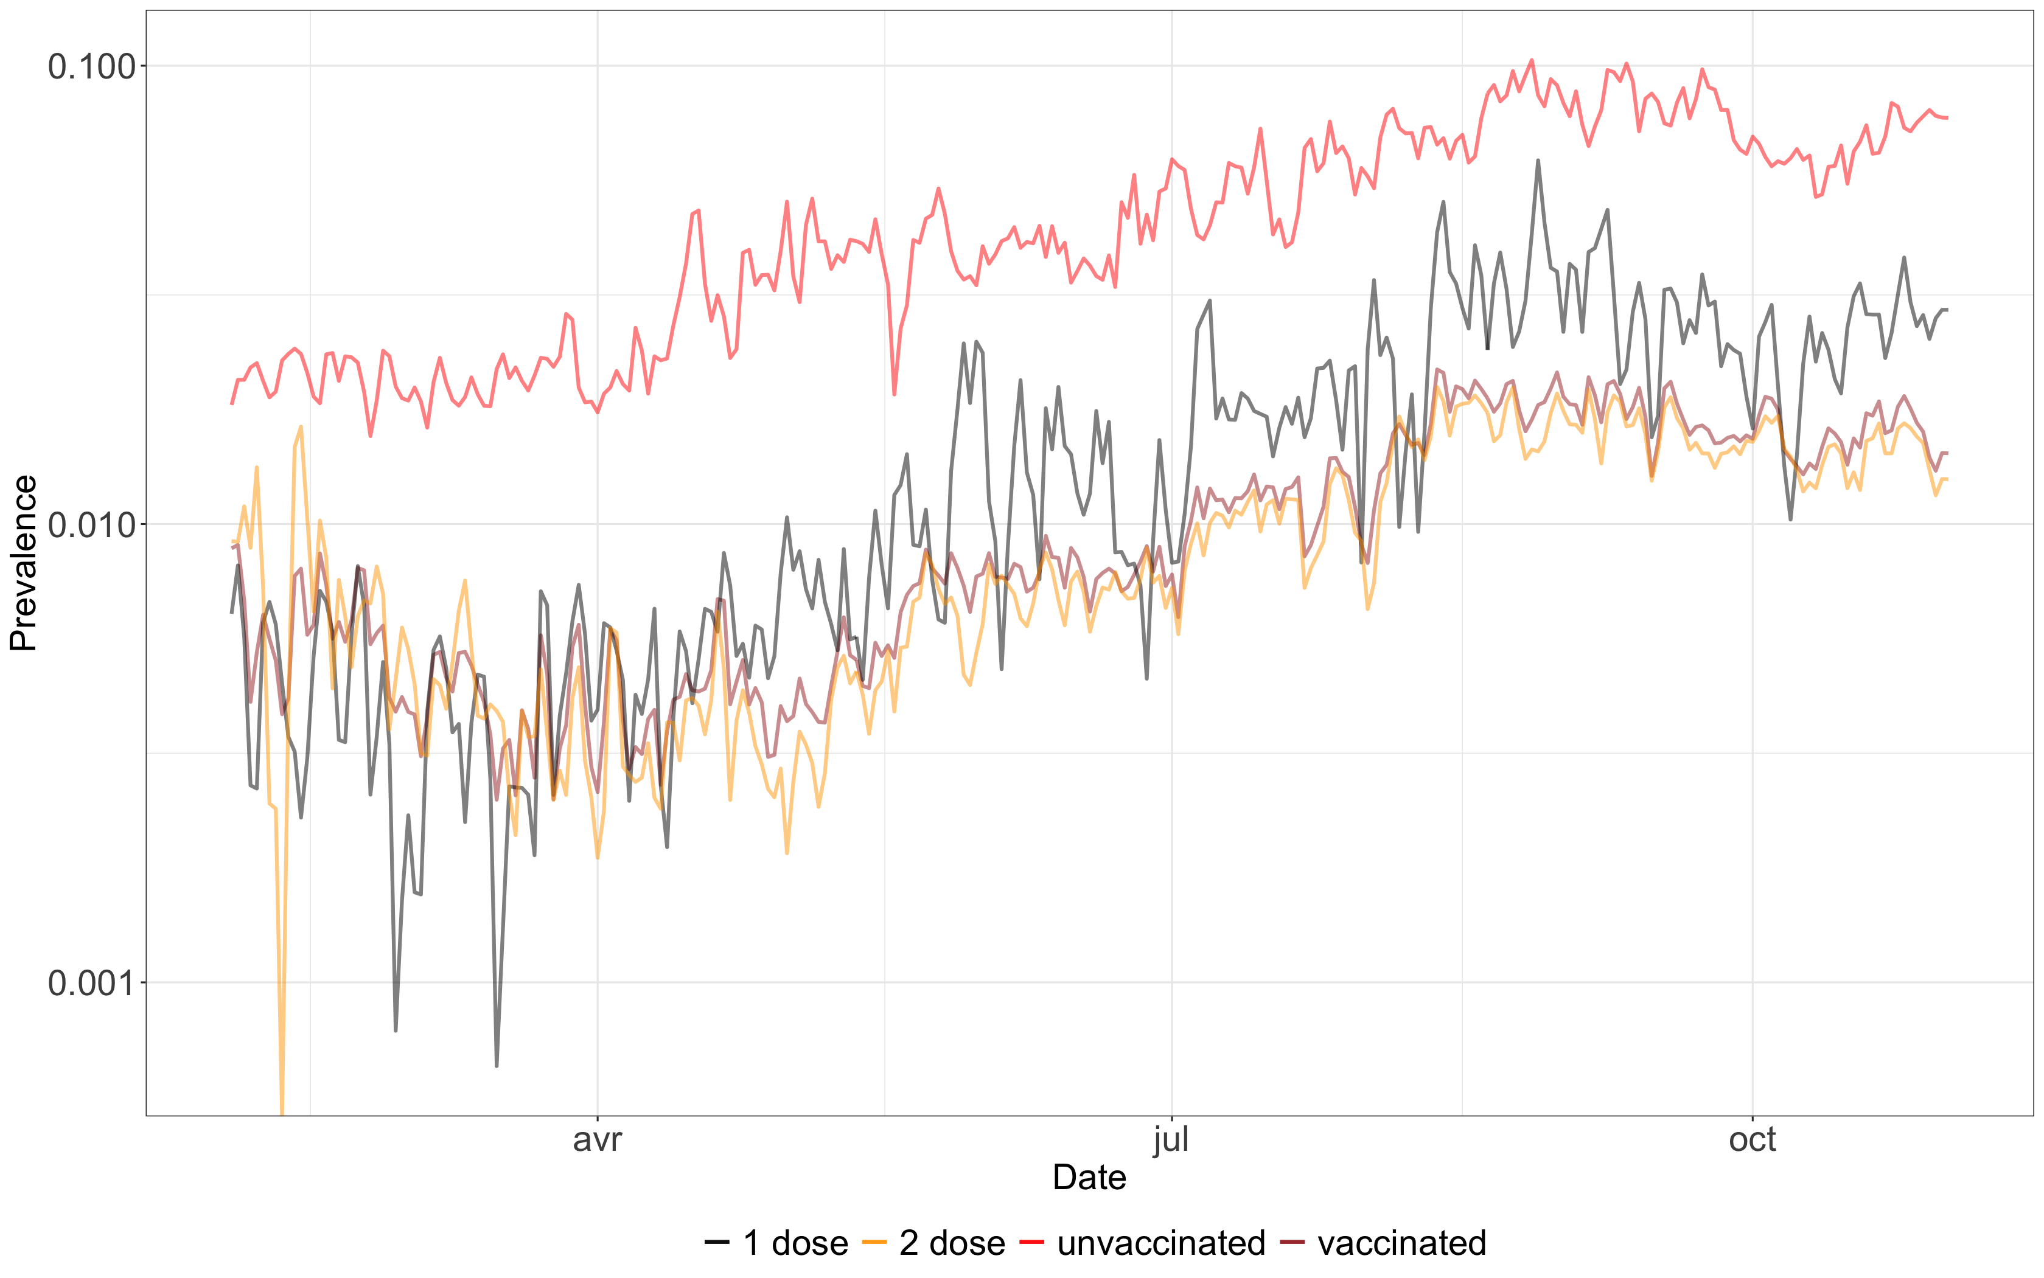
The prevalence in California among people with different levels of vaccination, estimated with Random Forest
Author : Mohamed Kacem Host org tutor : Antonio Fernández Anta ENSTA Tutor : Andrea Simonetto

Slide 14
Evaluating the classifiers
Confusion Matrix :
TP (True positive) – TN (True negative) – FP (False positive) – FN (False negative)
Performance Metrics :
- Accuracy = (TP+TN)/(TP+FP+FN+TN) - Precision = TP/(TP+FP) - Recall = TP/(TP+FN) - F1 Score = 2(Precision*Recall)/(Precision+Recall)
Author : Mohamed Kacem Host org tutor : Antonio Fernández Anta ENSTA Tutor : Andrea Simonetto

Slide 15
Training 80%
Testing 20%
The ground-truth
To have a realiable evaluation/Comparaison :
A random sampling 50 times for each state.
We calculate the averages of the performance metrics
Author : Mohamed Kacem Host org tutor : Antonio Fernández Anta ENSTA Tutor : Andrea Simonetto

Slide 16
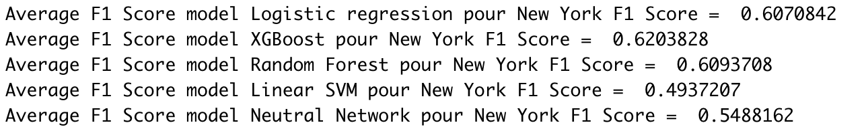
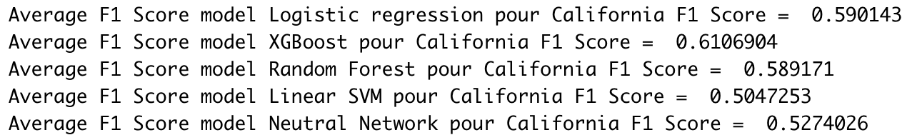
F1 Score -> limiting FP and FN
F1 score averages for some states using different ML models
Author : Mohamed Kacem Host org tutor : Antonio Fernández Anta ENSTA Tutor : Andrea Simonetto

Slide 17
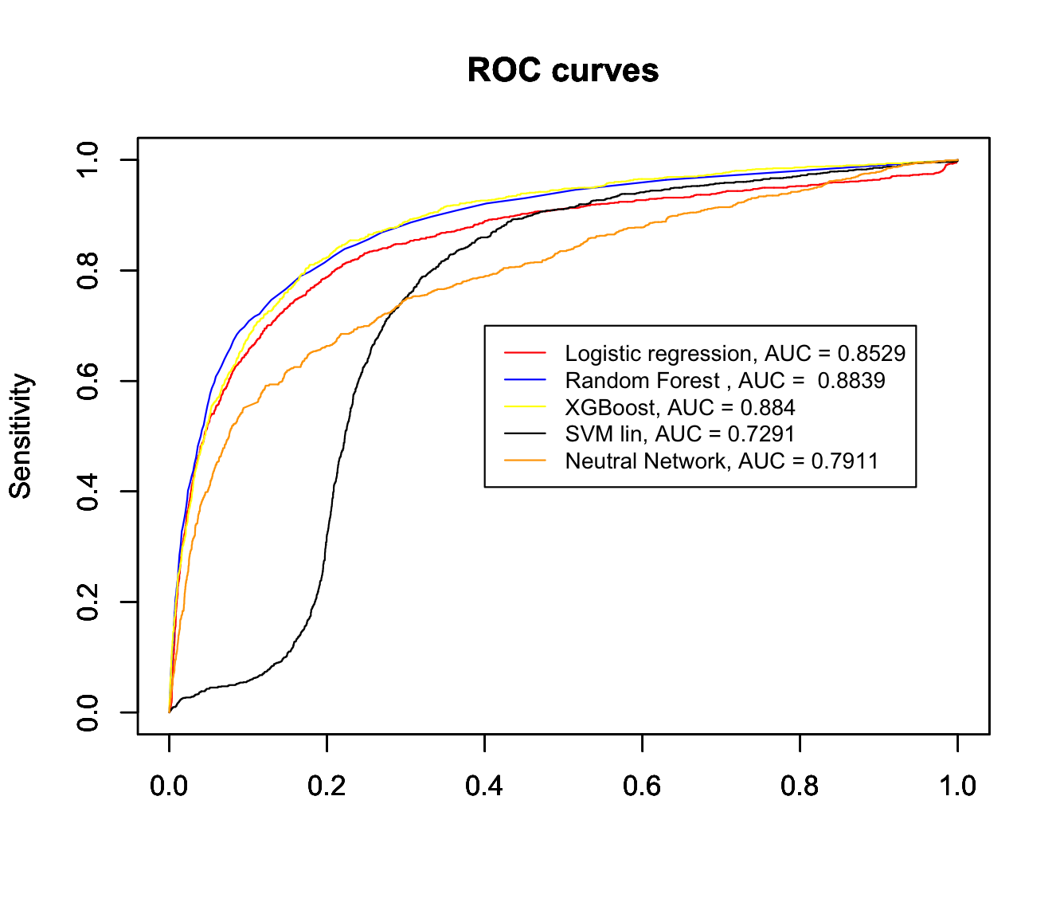
Author : Mohamed Kacem Host org tutor : Antonio Fernández Anta ENSTA Tutor : Andrea Simonetto

Slide 18
Conclusion & Discussion
Author : Mohamed Kacem Host org tutor : Antonio Fernández Anta ENSTA Tutor : Andrea Simonetto

Slide 19
THANK YOU
Author : Mohamed Kacem Host org tutor : Antonio Fernández Anta ENSTA Tutor : Andrea Simonetto

